Slide 1


Slide 2

Managing Mobile Devices
Configure, enroll, manage
xxxxxxx

Slide 3
Three Requirements
• Configure
• Enroll
• Manage

Slide 4
Three Solutions
Configure
  Configuration
Enroll
  OTA Enrollment
Manage
  Mobile Device Management

Slide 5
Technologies
Configuration Profiles
OTA Enrolment
Mobile Device Management

Slide 6

Configuration Profiles
XML (plist DTD) format
<?xml version="1.0" encoding="UTF-8"?>
<!DOCTYPE plist PUBLIC "-//Apple//DTD PLIST 1.0//EN" "http:// www.apple.com/DTDs/PropertyList-1.0.dtd">
<plist version="1.0">
<dict>
  <key>PayloadContent</key>
  <array>
      <dict>
        <key>PayloadDescription</key>
        <string>Configures device restrictions.</string> <key>PayloadDisplayName</key>
        <string>Restrictions</string>
        <key>PayloadIdentifier</key> <string>group.company.com.restrictions</string> <key>PayloadOrganization</key>
        <string></string>
        ...

Slide 7
Configuration Profiles
XML (plist DTD0 format
contains one or more payloads
  Exchange settings, IMAP and CalDAV accounts, etc.
  Certificates, shared secrets, VPN settings, etc.
  Passcode requirements, feature restrictions, etc.
Created via
  iPhone Configuration Utility
  Custom server script
  Commercial managment solution

Slide 8
Demo
iPhone Configuration Utility (iPCU)

Slide 9
Configuration Profiles
May be signed and encrypted
Install over USB, or over the air (OTA)
All payloads installed or removed together

Slide 10

Configuration Profiles
Carrot and stick approach
Combine restrictions and accounts in one profile

Slide 11
Technologies
Configuration Profiles
OTA Enrolment
Mobile Device Management

Slide 12
OTA Enrollment
Features
User login via web portal
Deliver custom profile
SCEP to deliver enrollment identity
  Profiles can be encrypted

Slide 13
Demo
OTA Enrollment

Slide 14

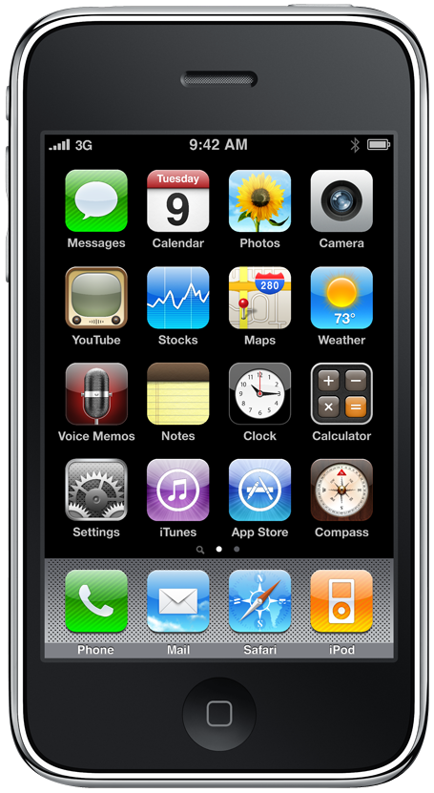


OTA Enrollment
How it works
1
0
Login in
Enter URL in Safari
3
2
Enroll Identity
(SCEP)
Authenticate Device
4
6
Make Custom
Encrypted Profile
Confirmation of
Installation
5
Install Profile

Slide 15
Technologies
Configuration Profiles
OTA Enrolment
Mobile Device Management

Slide 16
Mobile Device Management
Features
Manage devices on demand, over the air
Works over Wi-Fi and cellular networks
Transparent to the user

Slide 17
Mobile Device Management
Features
Initiation using Apple Push Notification
Communication over HTTPS
Comprehensive management features
  Remote commands
  Queries

Slide 18
Mobile Device Management
Remote Commands
  Install and remove configuration profiles
  Install and remove provisioning profiles
  Lock device
  Remove passcode
  Erase

Slide 19
Mobile Device Management
Queries
  Network details
    Bluetooth and Wi-FI MAC addresses
    ICCID
    Current and SIM carrier network
    Carrier settings version
    Phone number
    Date Roaming setting (on/off)

Slide 20
Mobile Device Management
Queries
  Network details
  Device information
    Device name
    UDID, IMEI and serial number
    Model name and number
    OS and build version
    Modem firmware version
    Total capacity and free space

Slide 21
Mobile Device Management
Queries
  Network details
  Device information
  Application details
    List of apps installed
    App ID, name and version
    Size of app and its data
    Provisioning profiles installed and their expirey dates

Slide 22
Mobile Device Management
Queries
  Network details
  Device information
  Application details
  Compliance and security information
    Installed Configuration Profiles
    Certificates and expiry dates
    List of restrictions in effect
    Data Protection capabaility
    Passcode compliance

Slide 23
Demo
Mobile Device Management

Slide 24


Mobile Device Management
How it works
0
2
3
OTA Enrollement
Install MDM
Profile
Bind to MDM
Server
1
Generate MDM Profile
MDM Server
Initial Configuration

Slide 25
Mobile Device Management
How it works
5
6
Device connects to
MDM Server
Send command, queries
and receive data
4
Send MDM
Push Notification
MDM Server
On-going Management

Slide 26

Mobile Device Management
Managed Profiles
MDM Server
MDM
May examine all profiles
May remove or replace only
Managed Profiles
Managed Profiles may be locked
(cannot be removed)
Root MDM profile may not be locked
User may terminate MDM relationship
at any time
Managed Profiles
Removing Root MDM profile
removes all Managed Profiles

Slide 27
Mobile Device Management
Carrot and stick approach
Two approaches
  Restrictions and accounts in a single profile
  Using MDM
    Install restrictions in a locked profile
    Wait for user to comply
    Install account in seperate profile

